Slide 1

Correlation and
Simple Linear Regression
Chapter 4

Slide 2
Summarizing Bivariate Data
Bivariate data exists in ordered pairs (x, y). Scatterplots and correlation coefficients will reveal trends between variables x and y. The least-squares regression line lets us predict future data values based on historical data values.
Objectives
▫ Read textbook sections 4.1 - 4.3.
▫ Create a scatterplot.
▫ Describe the form, direction, and strength of the plot.
▫ Compute and interpret the correlation coefficient.
▫ Build a linear model; interpret the coefficients.
▫ Use the linear model to make predictions (while avoiding extrapolation).
▫ Compute and interpret the coefficient of determination.
▫ Calculate residuals.
▫ Understand outliers and influential points.

Slide 3
Correlation
Bivariate data = two variables (x and y).
How are they related?
What types of patterns or trends can we see?
Some examples of paired variables include:
  height and weight,
  study time and test score,
  hours worked and income.
Variable x = independent, explanatory, predictor variable.
Variable y = dependent, outcome, response variable.

Slide 4
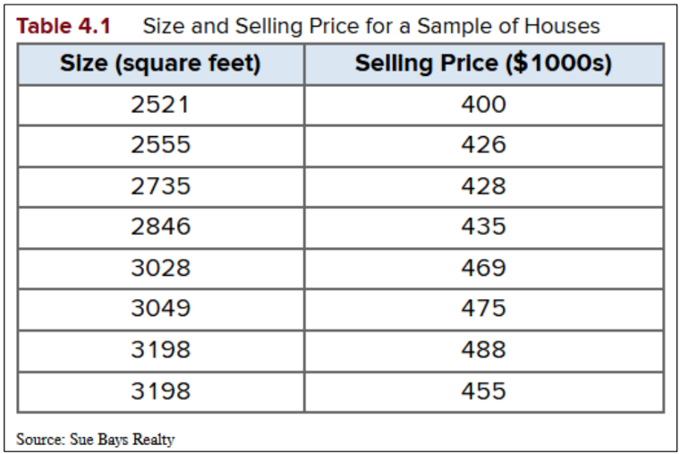
Housing Data
First ordered pair = (2521, 400)
Create a vector per variable

Slide 5
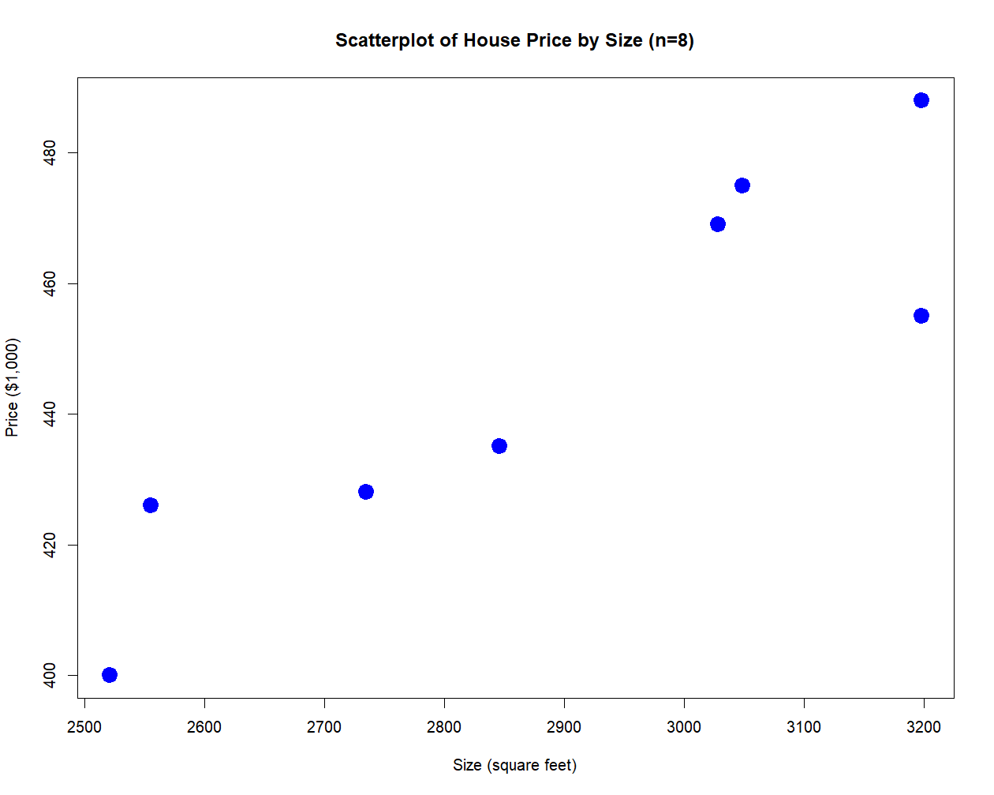
Make a
Scatterplot
graph parameters

Slide 6
Describing Scatterplots
We describe the shape of scatterplots in terms of form, direction, and strength.
Form - Linear vs. Nonlinear
  Linear plots only go in one direction in roughly a straight line.
  Nonlinear plots have curvature or go in more than one direction.
Direction – Positive vs. Negative
  Positive correlation means that as x increases, y also increases.
  Negative correlation means that as x increases, y decreases. Also called an inverse correlation.
  If absolutely no pattern can be seen, then there is no correlation.
Strength – Weak, Medium, Strong
  The stronger the correlation between x and y, the closer the dots fall on an invisible line.
  Weaker correlation makes the dots appear widely dispersed.
  Do a visual inspection first. Then measure more accurately with the correlation coefficient.

Slide 7
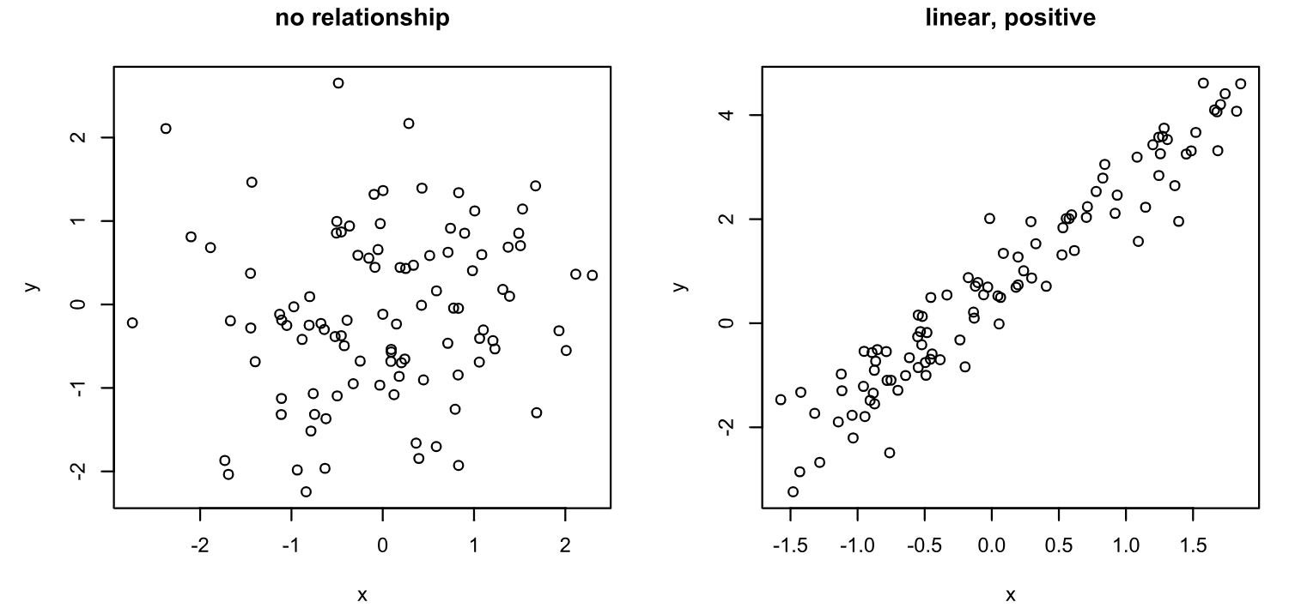
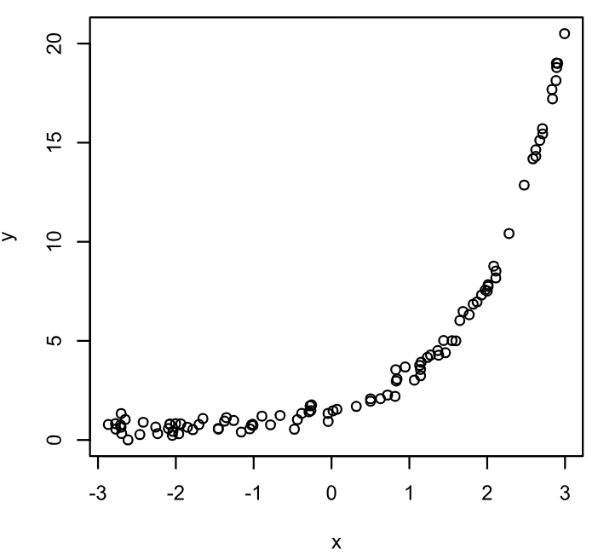
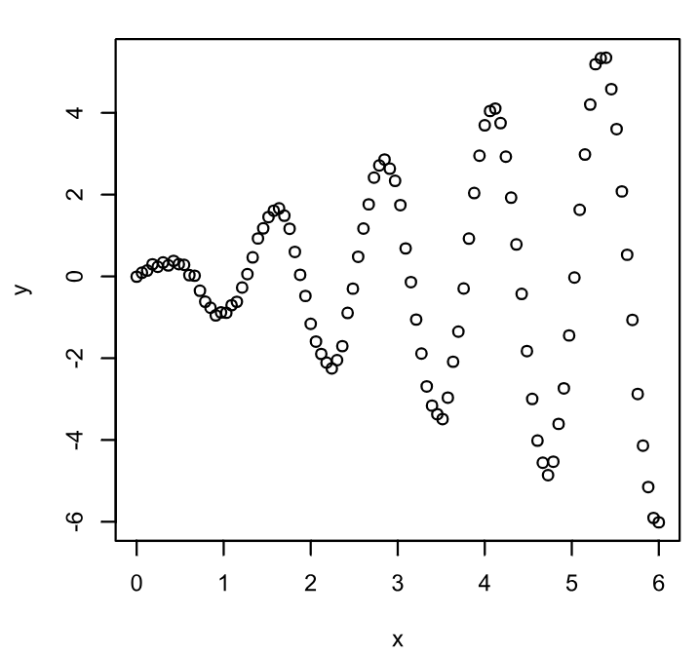
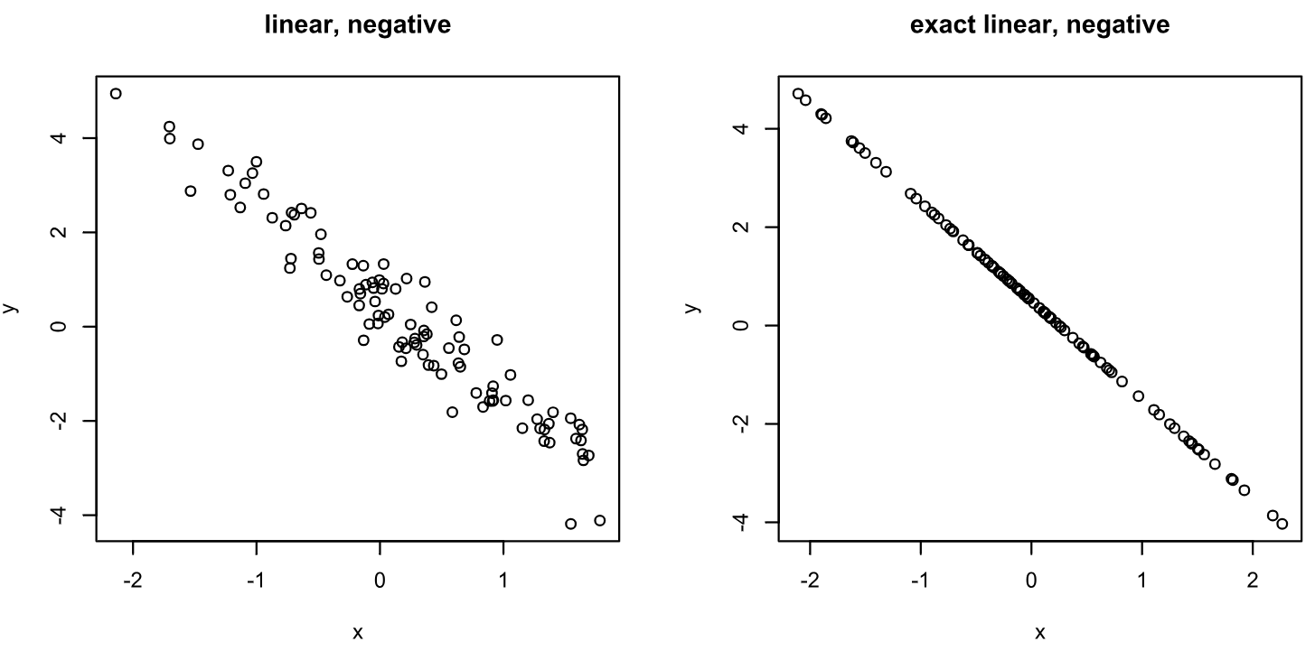
Form
Linear
Non-Linear

Slide 8
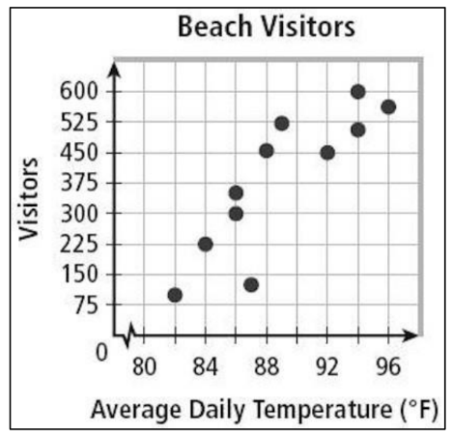
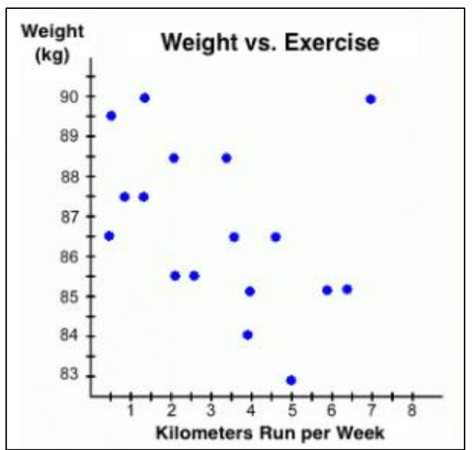
Direction
Positive
Negative

Slide 9
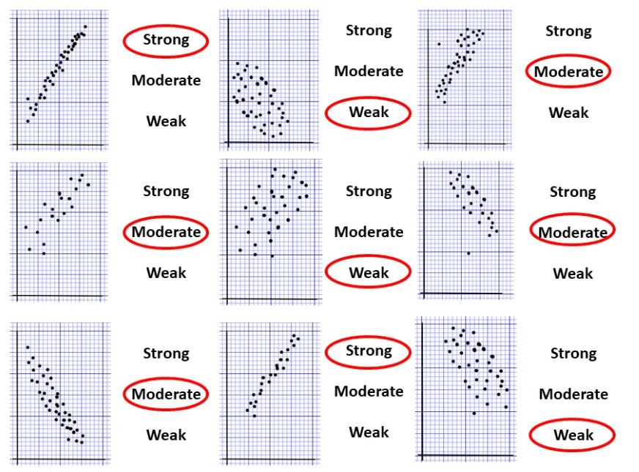
Strength (Visual)

Slide 10
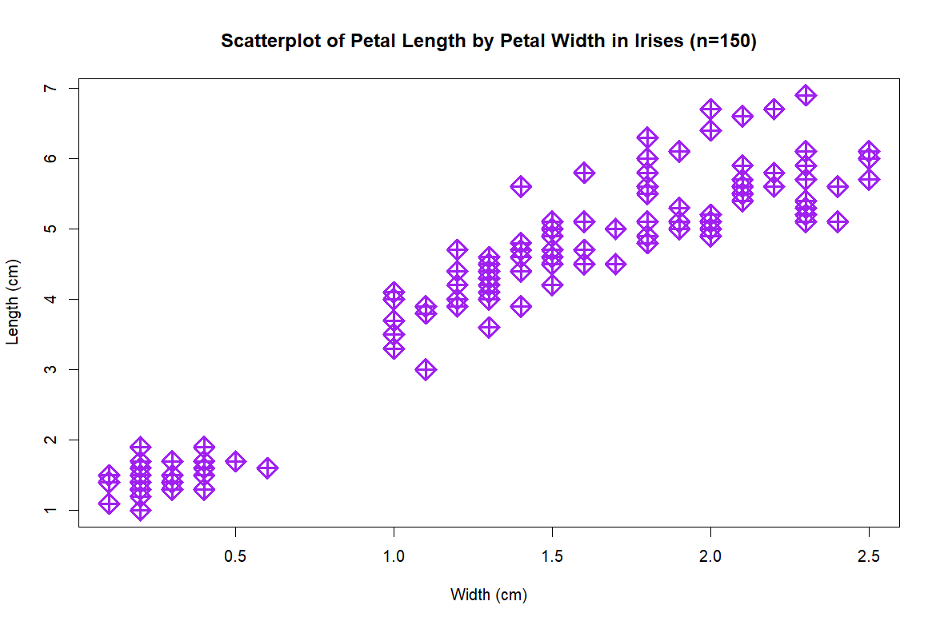
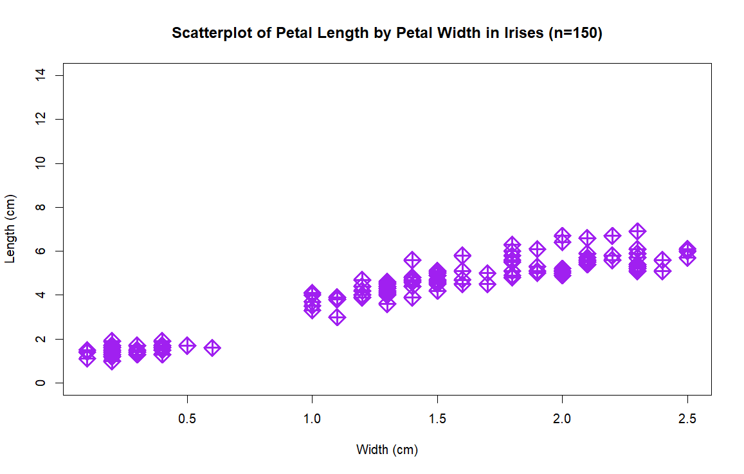
Visual Inspection of Strength
The strength of a scatterplot can be difficult to determine by sight alone. To measure the strength of the relationship between x and y, a visual inspection is not sufficient. We must compute the correlation coefficient, r.

Slide 11
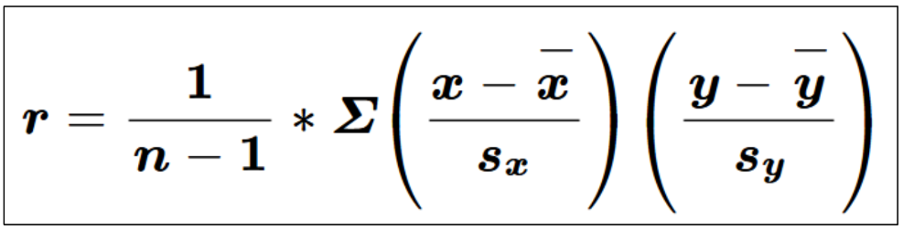
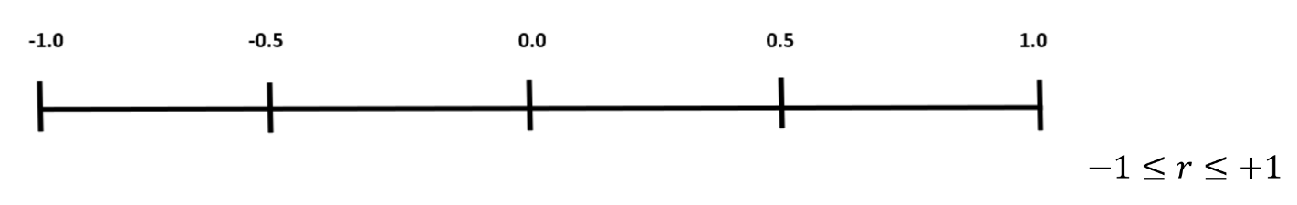
The Correlation Coefficient = r
r tells us the strength and direction of the relationship between x and y.
r is always between -1 and 1 [rounded to 3 decimal places].
r will remain the same regardless of the units of x and y.
r will remain the same even if we were to switch the x and y variables.
Only use r to measure linear associations, NOT nonlinear ones.
r is sensitive to outliers (NOT resistant).

Slide 12
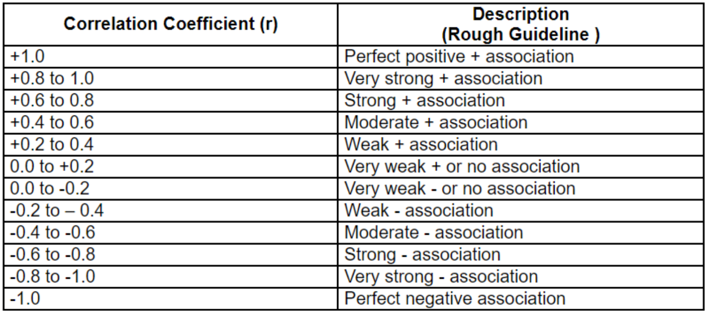
Matching Numbers to Words

Slide 13
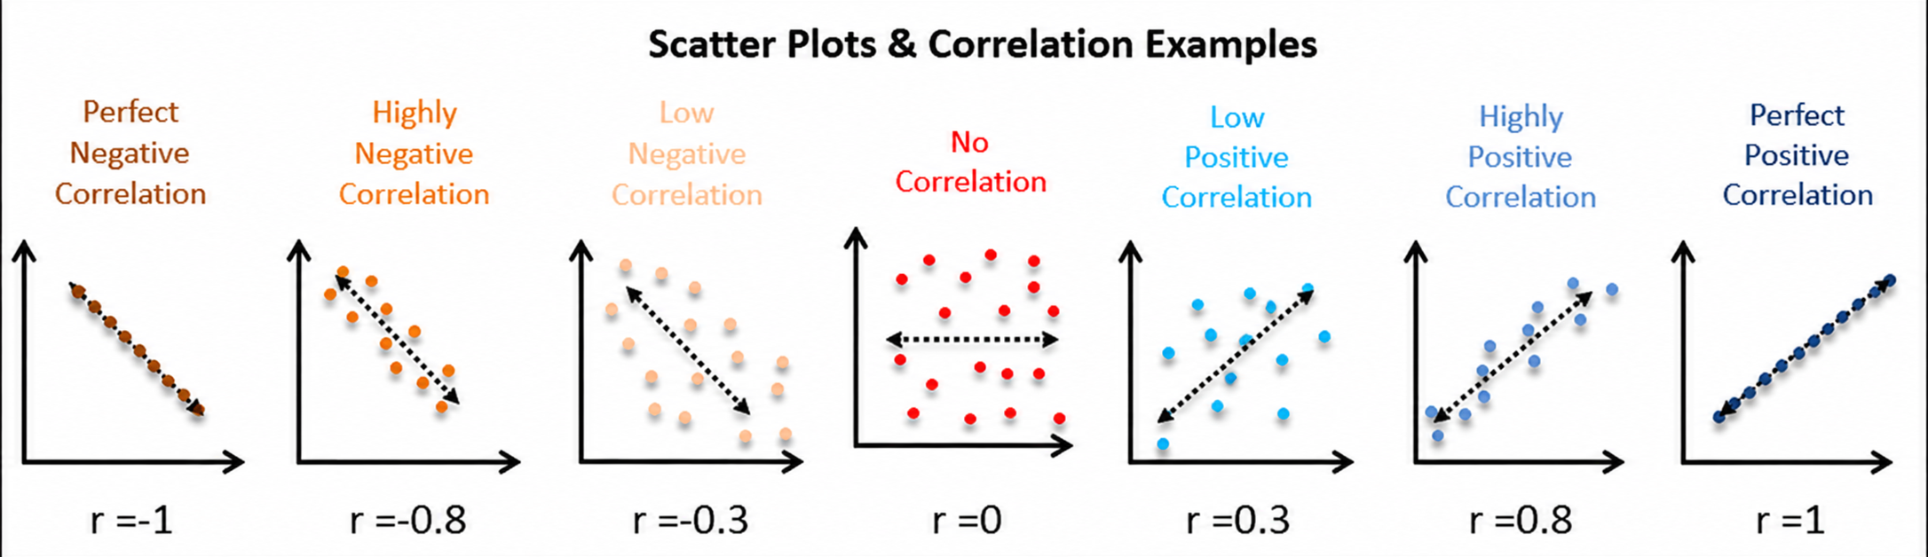
Example Plots

Slide 14
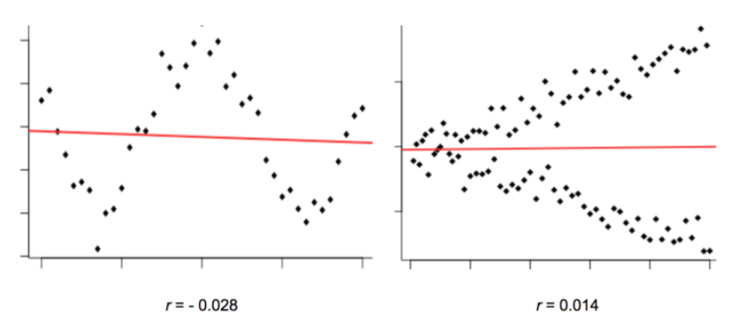
Measure r ONLY for Linear Plots
These scatterplots clearly display a strong correlation between x and y, but because the relationship is nonlinear, the correlation coefficient is extremely weak and misleading. In this course, we will only analyze bivariate data that form a linear relationship.

Slide 15
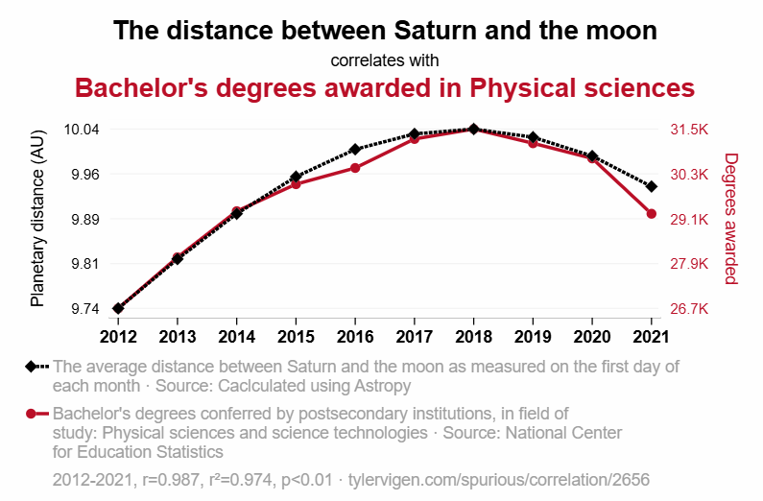
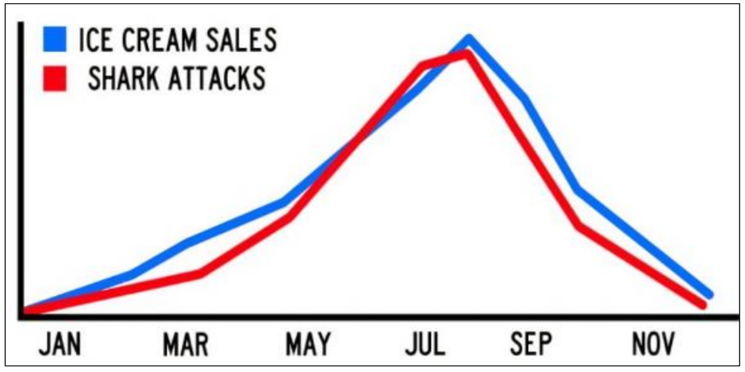
Correlation ≠ Causation
Spurious Correlation Example

Slide 16
Confounding
“Confounding occurs when an apparently causal relationship between an exposure (e.g. a treatment) and an outcome is, in reality, distorted by the effect of a third variable (the confounder). ... A classic example of confounding refers to the observed correlation between birth order and the risk of Down syndrome, where the incidence of Down syndrome may seem to be linked directly to the position in birth order (i.e. the more older siblings, the higher the risk of Down syndrome). However, women giving birth to their second or third child are usually older than women giving birth to their first child. Thus, position in birth order is linked to maternal age.” source
5 Real-World Examples of Confounding
Causation vs. Correlation Explained

Slide 17
Good Science
Statistics without human intuition and reason is meaningless and harmful.
Assuming causation can result in
  pseudoscience,
  harmful stereotypes against people,
  medical myths,
  overall poor decision making.
Explore more deeply! Ask questions! Look beyond the graph!
Search for confounders. A confounder is a (sometimes hidden) third variable, related to both x and y, that can be the true causal agent.
Assuming that correlation necessarily means causation is related to other logical fallacies, like cherry-picking, trusting anecdotal evidence, confirmation bias, etc.
Good questions to ask:
  Who paid for this study?
  Who is presenting you with this information?
A note about science vs. spirituality…

Slide 18
Practice
Interpret each correlation coefficient (describe in words):
  -0.004
  0.718
  -0.993
  0.522
  1.437
For each pair of variables, state which is x and which is y:
  outside temperature; number of drinks purchased.
  score of a test; amount of time studied.
  percentage of lemon juice in lemonade; pH level.
  the age of a car; the price of a car.
True or false: the following two lines of code will produce the same result.
  cor(x, y)
  cor(y, x)
True or false: the correlation coefficient between the dosage frequency of medicine ABC and the symptoms of illness XYZ is –0.886. This is sufficient evidence to conclude that the medicine reduces symptoms.

Slide 19
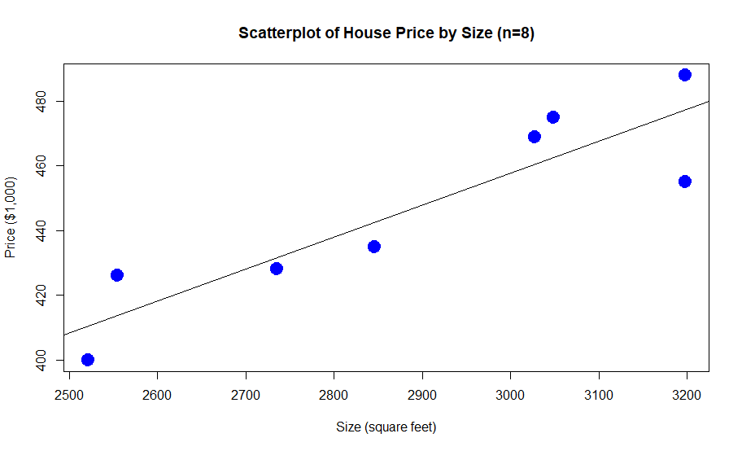
The Least-Squares Regression Line

Slide 20
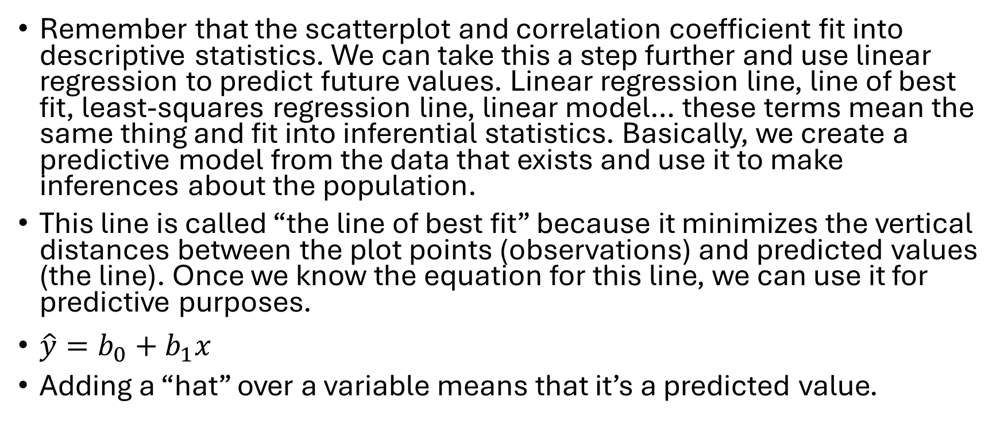
The Line of Best Fit
Remember that the scatterplot and correlation coefficient fit into descriptive statistics. We can take this a step further and use linear regression to predict future values. Linear regression line, line of best fit, least-squares regression line, linear model… these terms mean the same thing and fit into inferential statistics. Basically, we create a predictive model from the data that exists and use it to make inferences about the population.
This line is called “the line of best fit” because it minimizes the vertical distances between the plot points (observations) and predicted values (the line). Once we know the equation for this line, we can use it for predictive purposes.
$\hat{y}=b_{0}+b_{1}x$
Adding a “hat” over a variable means that it’s a predicted value.

Slide 21
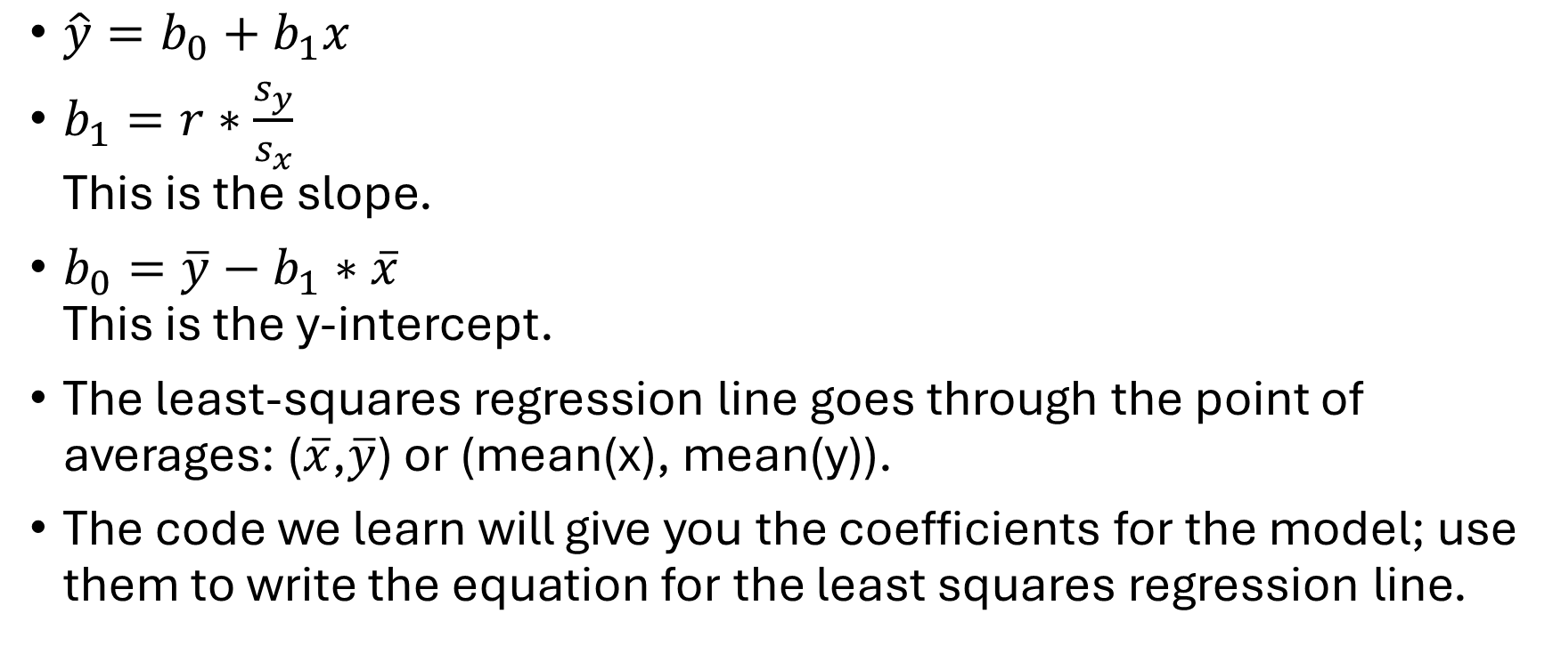
The Line of Best Fit, continued
$\hat{y}=b_{0}+b_{1}x$
$b_{1}=r∗\frac{s_{y}}{s_{x}}$
This is the slope.
$b_{0}=\overline{y}−b_{1}∗\overline{x}$
This is the y-intercept.
The least-squares regression line goes through the point of averages: ($\overline{x}$,$\overline{y}$) or (mean(x), mean(y)).
The code we learn will give you the coefficients for the model; use them to write the equation for the least squares regression line.

Slide 22


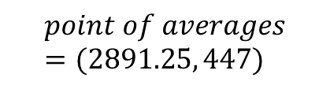
The Linear Model
$$\hat{y}=160.1939+0.0992x$$
$$\hat{price}=160.1939+0.0992size$$
$$point of averages=(2891.25, 447)$$

Slide 23
Practice
What is the predicted price of a house with a size of 2,750 square feet?
What is the predicted price of a house with a size of 2,500 square feet?
$450,000 is the predicted price of a house based on what size?
If a house decreased in size by 200 square feet, by how much would the price change?

Slide 24
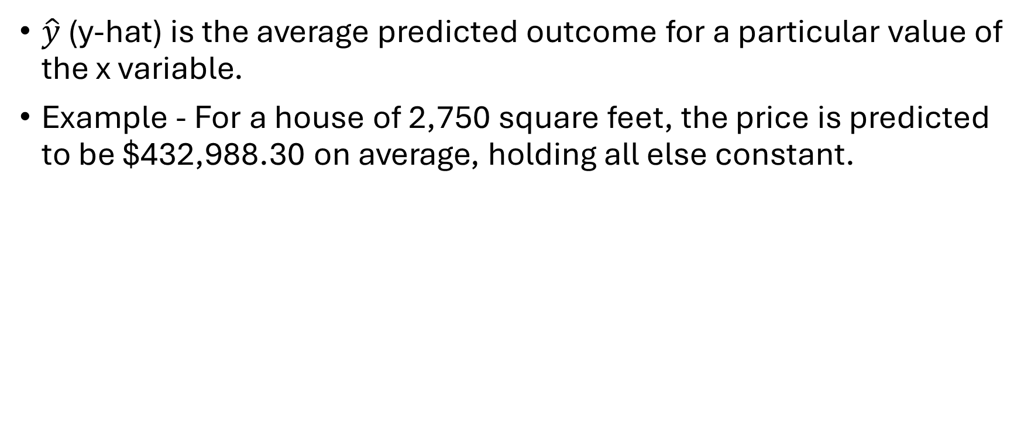
Interpretations – predicted y
$\hat{y}$ (y-hat) is the average predicted outcome for a particular value of the x variable.
Example - For a house of 2,750 square feet, the price is predicted to be $432,988.30 on average, holding all else constant.

Slide 25
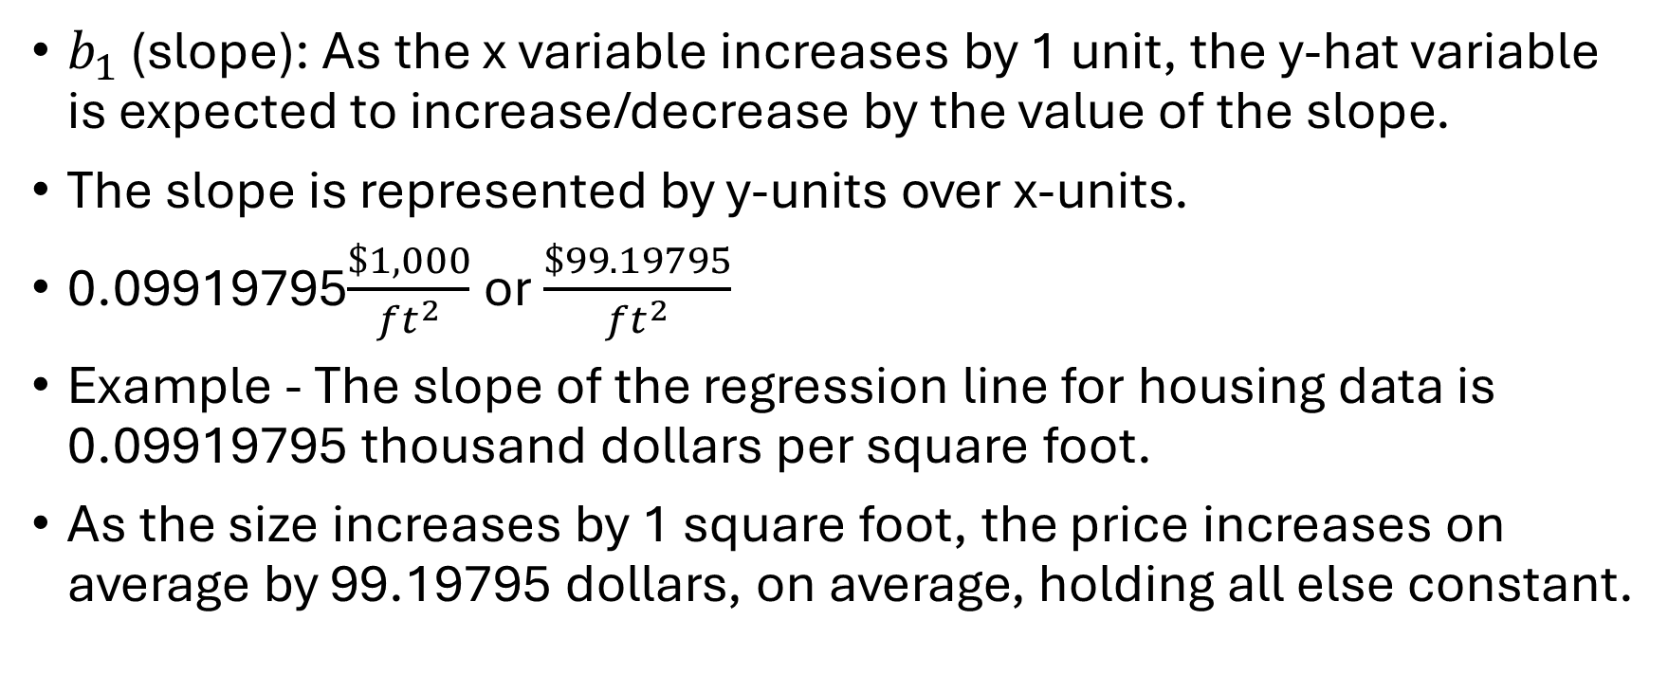
Interpretations – slope
$b_{1}$ (slope): As the x variable increases by 1 unit, the y-hat variable is expected to increase/decrease by the value of the slope.
The slope is represented by y-units over x-units.
0.09919795$\frac{\$1,000}{{ft}^{2}}$ or $\frac{\$99.19795}{{ft}^{2}}$
Example - The slope of the regression line for housing data is 0.09919795 thousand dollars per square foot.
As the size increases by 1 square foot, the price increases on average by 99.19795 dollars, on average, holding all else constant.

Slide 26
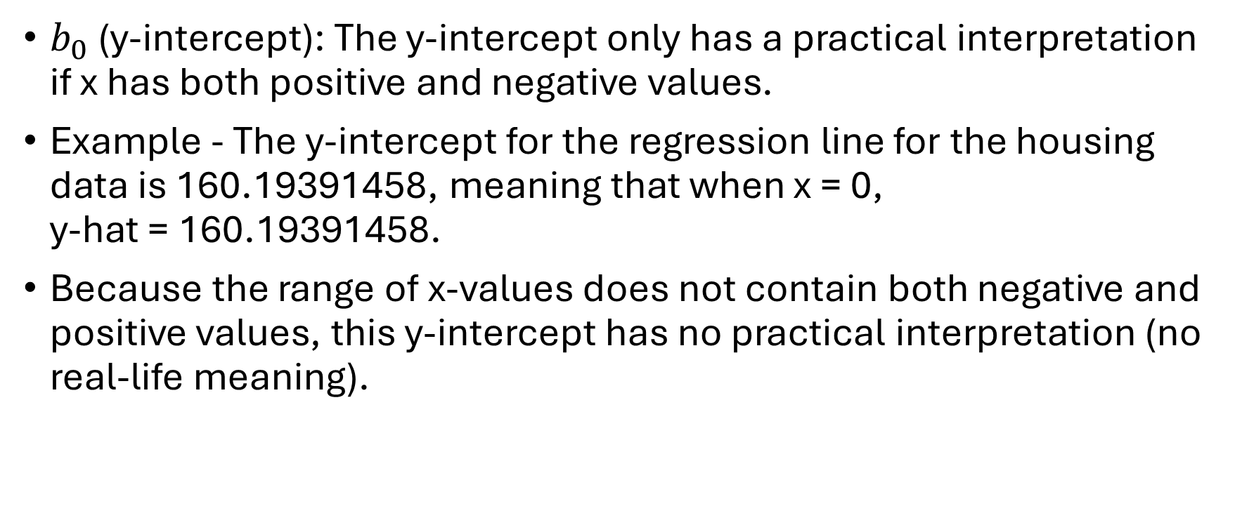
Interpretations – y-intercept
$b_{0}$ (y-intercept): The y-intercept only has a practical interpretation if x has both positive and negative values.
Example - The y-intercept for the regression line for the housing data is 160.19391458, meaning that when x = 0,
y-hat = 160.19391458.
Because the range of x-values does not contain both negative and positive values, this y-intercept has no practical interpretation (no real-life meaning).

Slide 27

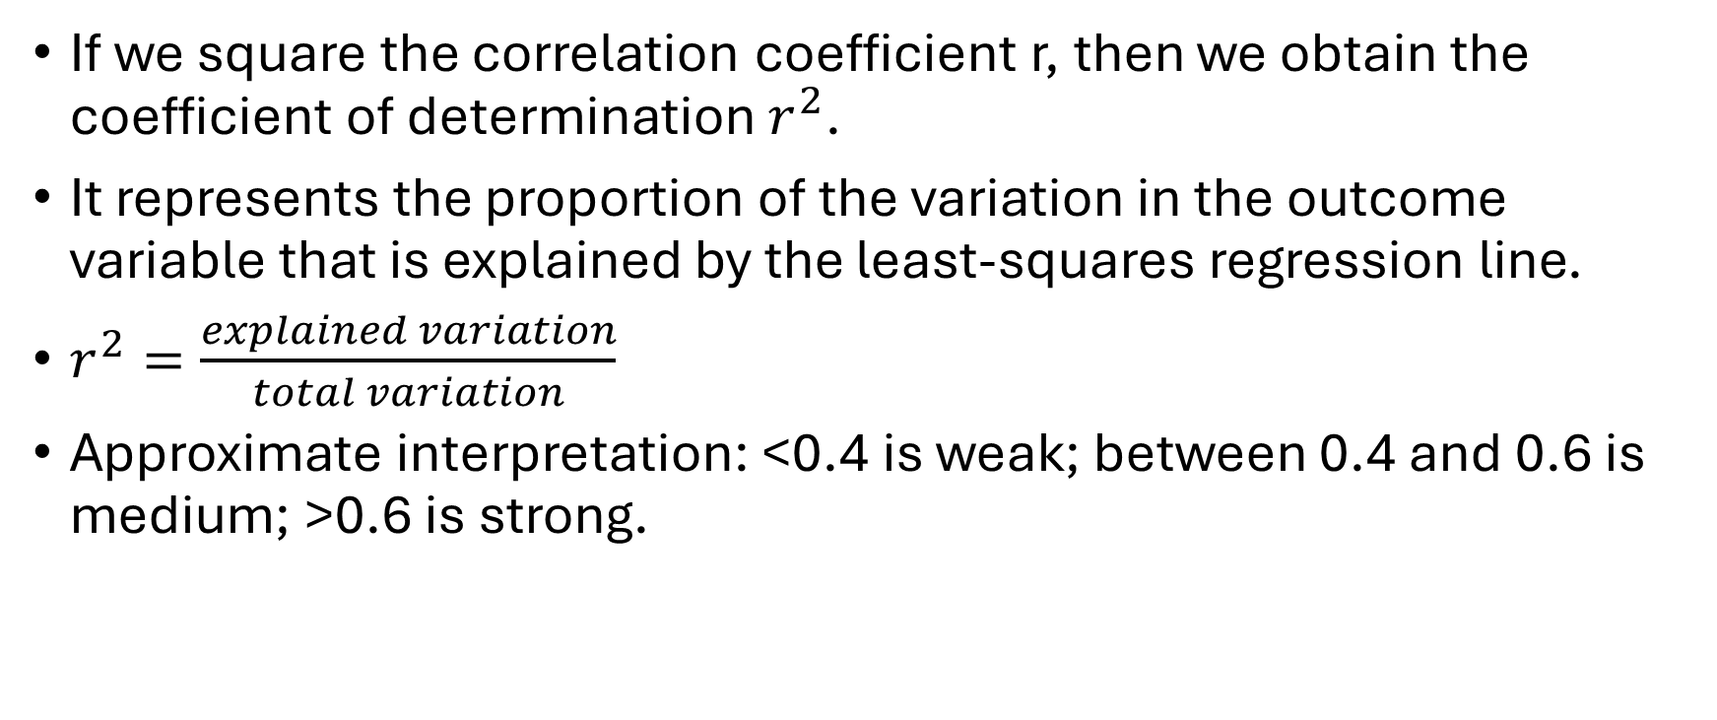
The Coefficient of Determination ($r^{2}$)
If we square the correlation coefficient r, then we obtain the coefficient of determination $r^{2}$.
It represents the proportion of the variation in the outcome variable that is explained by the least-squares regression line.
$r^{2}=\frac{explained variation}{total variation}$
Approximate interpretation: <0.4 is weak; between 0.4 and 0.6 is medium; >0.6 is strong.

Slide 28
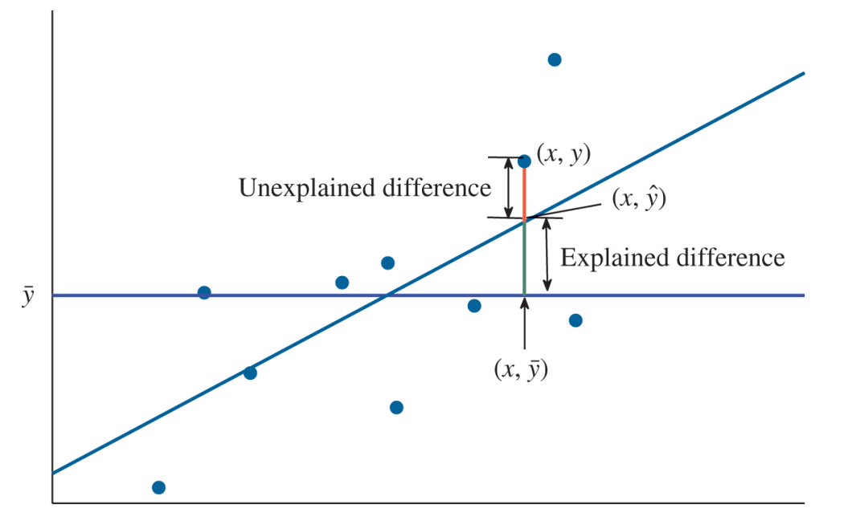
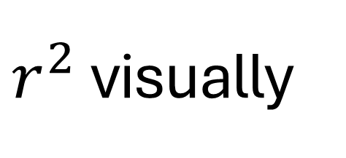
$r^{2}$ visually

Slide 29
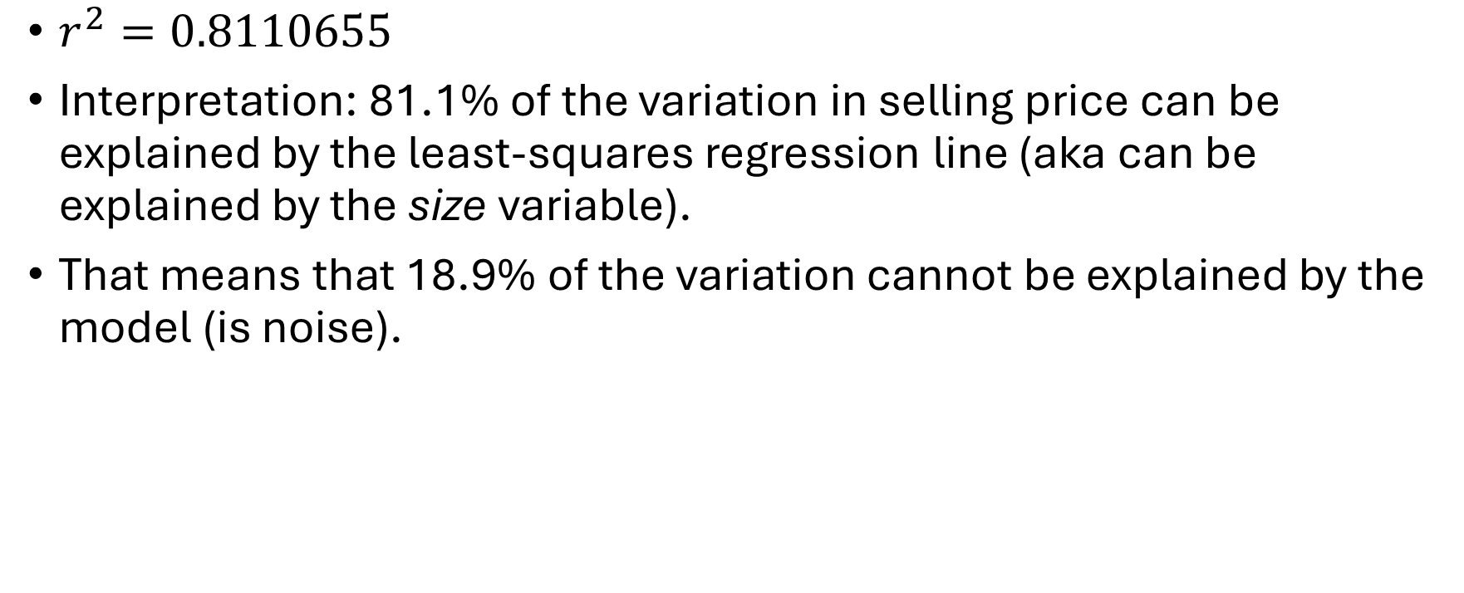
Housing Data Variation
$r^{2}=0.8110655$
Interpretation: 81.1% of the variation in selling price can be explained by the least-squares regression line (aka can be explained by the size variable).
That means that 18.9% of the variation cannot be explained by the model (is noise).

Slide 30
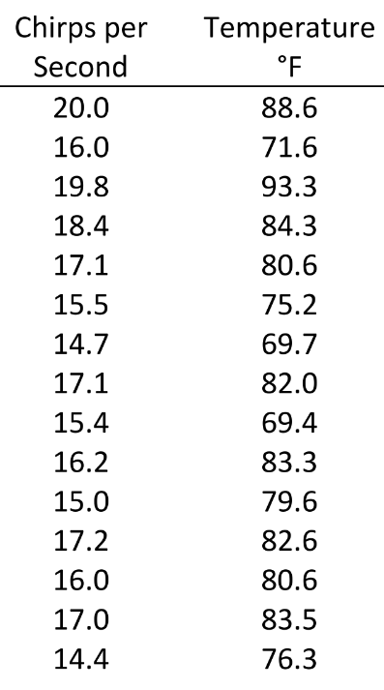
Crickets Practice
Practice: The table to the right displays data collected about the striped ground cricket, found here. The data is in your R script. Answer the questions on the next slide.

Slide 31
Crickets Practice, continued
Which variable is x and which is y?
How many observations are there?
Create a scatterplot.
What can we determine about the correlation from the scatterplot?
What is the correlation coefficient? What does it mean?
Compute the linear regression equation.
Interpret the y-intercept.
State and interpret the slope.
Compute and interpret the coefficient of determination.
What is the predicted frequency of chirps for 70°F?
What is the predicted frequency of chirps for 85°F?
If the temperature increases by 10°F, the frequency of chirps is expected to increase by how much?
*Review each answer. Pay close attention to the units of measure for each answer. Providing the wrong units of measure signifies a misunderstanding of the lessons in chapter 4.

Slide 32
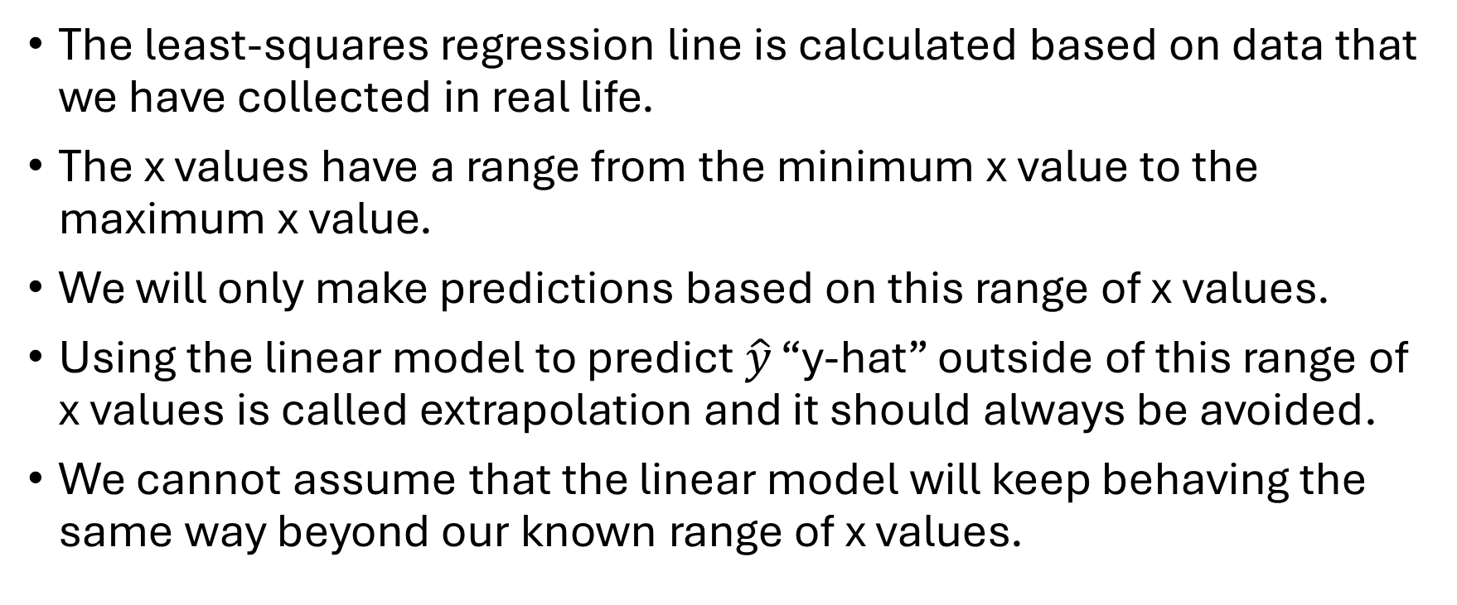
Extrapolation
The least-squares regression line is calculated based on data that we have collected in real life.
The x values have a range from the minimum x value to the maximum x value.
We will only make predictions based on this range of x values.
Using the linear model to predict $\hat{y}$ “y-hat” outside of this range of x values is called extrapolation and it should always be avoided.
We cannot assume that the linear model will keep behaving the same way beyond our known range of x values.

Slide 33
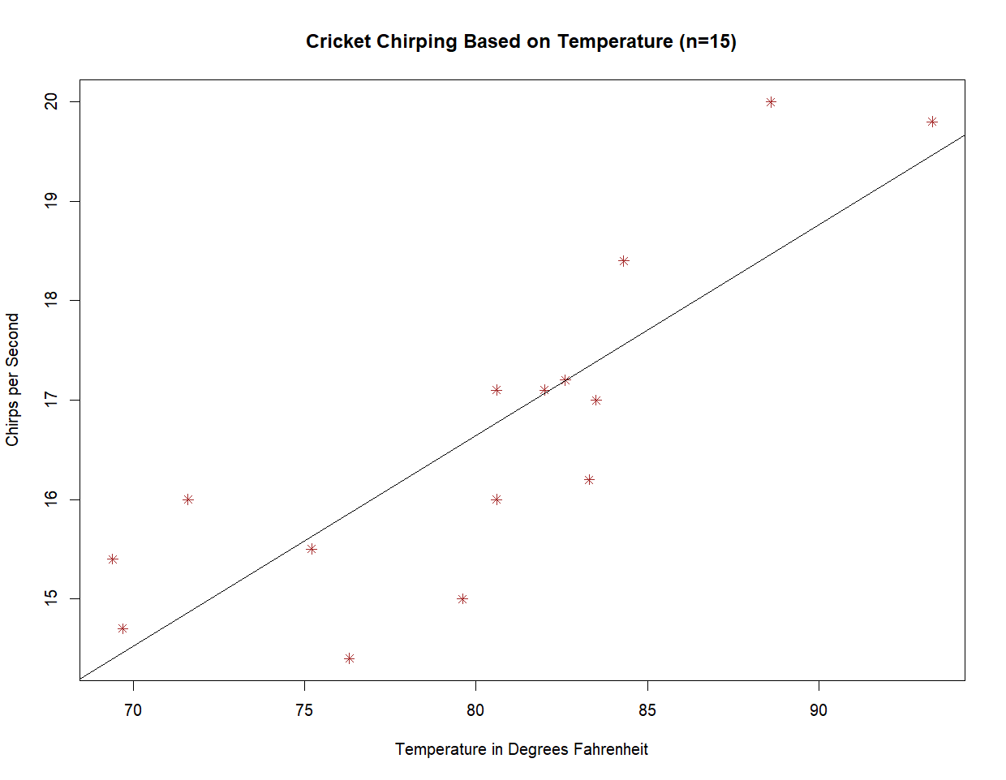
Assumptions vs.
Logic…

Slide 34
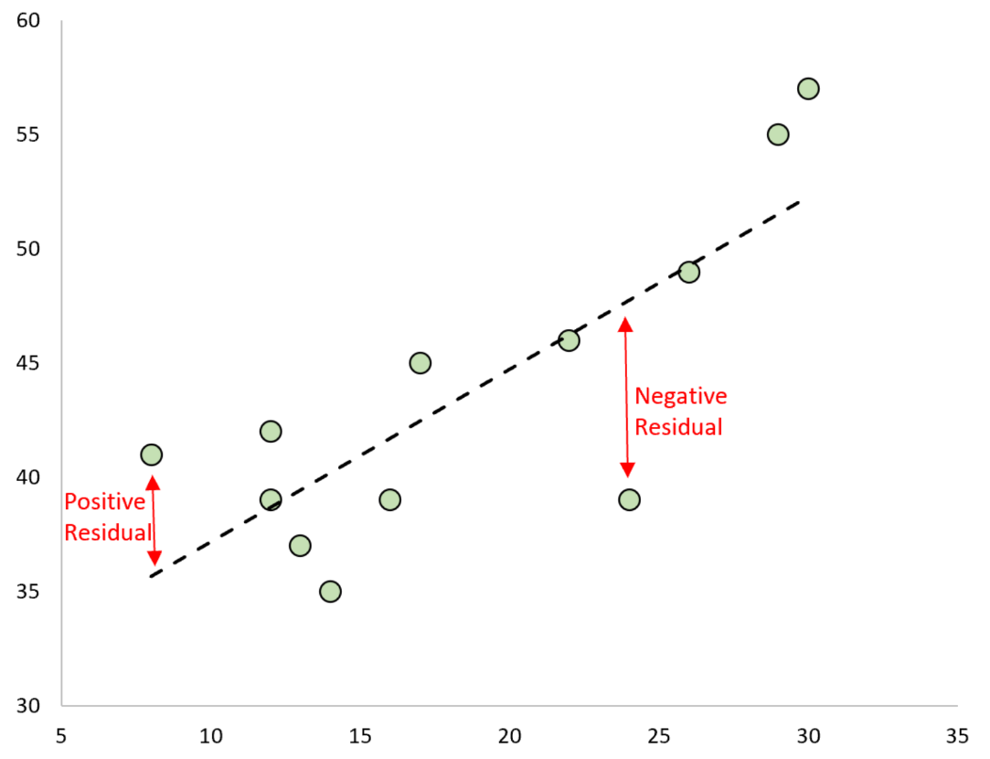
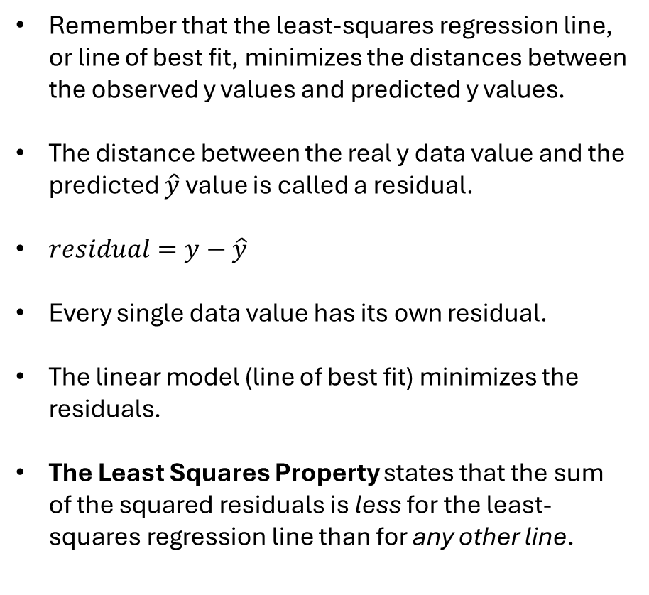
Residuals
Remember that the least-squares regression line, or line of best fit, minimizes the distances between the observed y values and predicted y values.
The distance between the real y data value and the predicted $\hat{y}$ value is called a residual.
$residual=y−\hat{y}$
Every single data value has its own residual.
The linear model (line of best fit) minimizes the residuals.
The Least Squares Property states that the sum of the squared residuals is less for the least-squares regression line than for any other line.

Slide 35
Outliers and Influential Points
What does it mean if a data value is an outlier?
If an ordered pair includes an outlier (in x or y or both), then it could potentially skew the location of the least-squares regression line. This is an influential point.
It is a good idea to identify outliers and compare your plots with vs. without them.
Let’s study this scatterplot of farmland vs. land area of states:

Slide 36
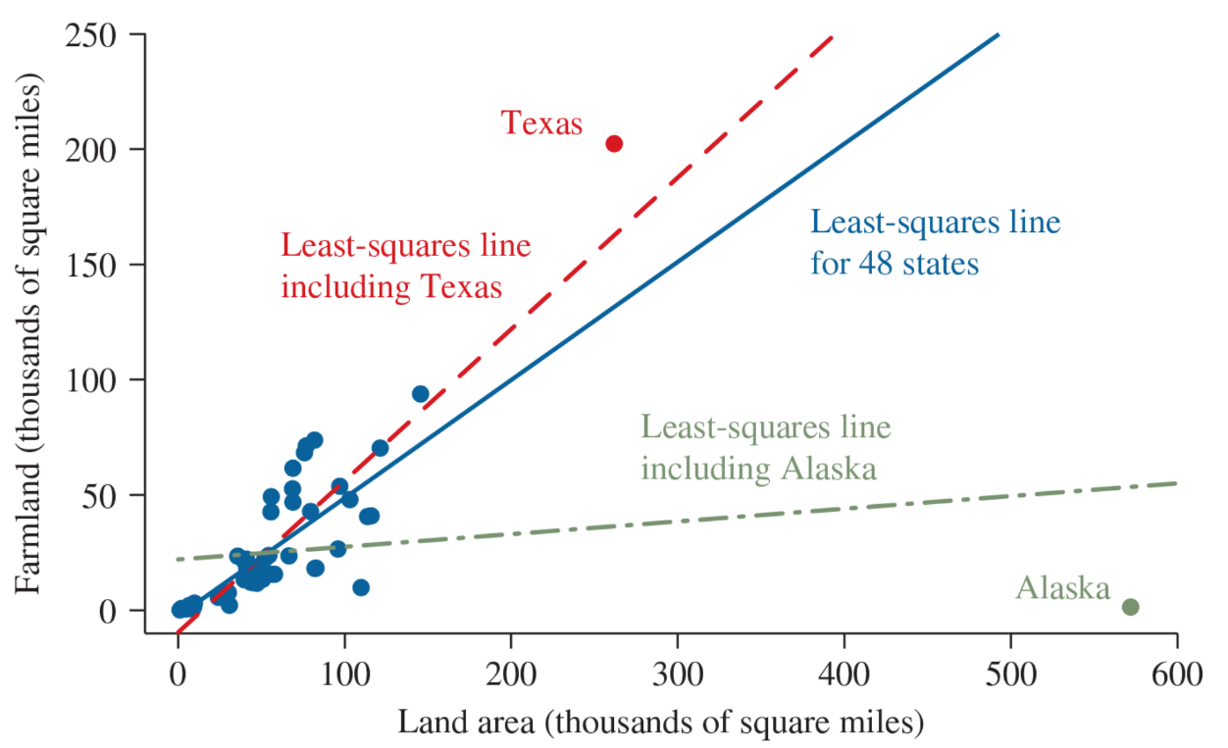
Land Area
What kind of outlier is Texas? How does it affect the regression line?
What kind of outlier is Alaska? How does it affect the regression line?
When you have an outlier, investigate more! We don’t want to delete it without asking further questions. Is it a mistake? A typo? An anomaly? Does it reveal something important to us?
Make note of it and set it aside. Run your analyses with and without the outliers.

Slide 37
Star Wars Practice
Let’s look at the Star Wars data set to study height vs. mass.
Create a scatterplot of mass by height.
Are there any influential points to worry about? If so, let’s set them aside.
Describe the scatterplot of your new data set.
Compute and interpret the correlation coefficient.
Find the least squares regression line.
State and interpret the slope.
How can we use the model for predictions while avoiding extrapolation?
Use the model to predict the mass of a character who is 100 cm tall.
Use the model to predict the mass of a character who is 200 cm tall.
Find the residual for Luke Skywalker.
Find the residual for Boba Fett.

